Slide 1
Ready your data. Ground your AI.
Let's find the use cases worth building.
Prepared for AEs and SEs
AI USE CASE DISCOVERY

Slide 2
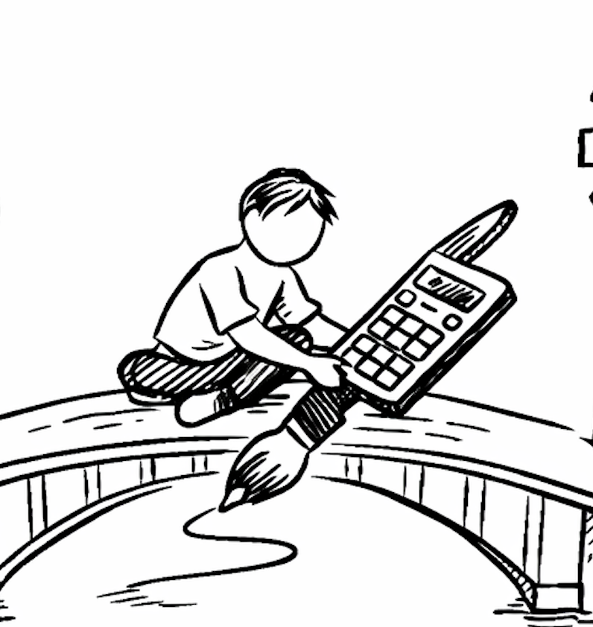
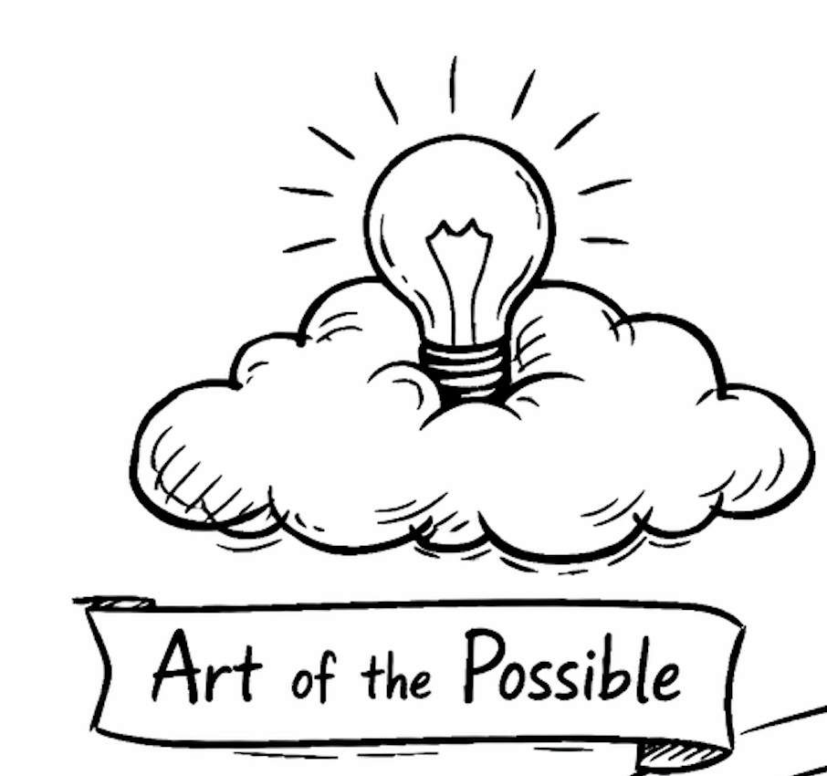
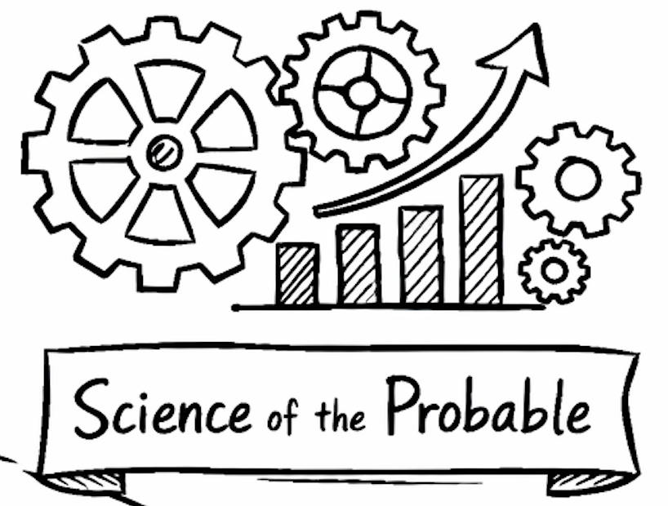

Your experts spend their days on manual work
Why AI, and why it needs your data
Skilled people burn hours on repetitive, manual steps that don’t scale.
AI can take that toil, if it truly understands your business.
Out of the box it doesn’t: it fills the gaps by guessing.
Trust erosion: Confident, wrong answers erode trust, and the fix isn't a bigger model. So what's actually missing?
Action: Through a use case discovery workshop, understand your data, your platform, your daily operations, and get ready for AI solutions
AI Specialist & FDE

Slide 3
The gap isn't capability — it's a missing semantic layer
Why bare RAG + bare Agent hallucinate
Bare RAG
Bare Agent
Matches text, not meaning.
Finds a doc with “inventory,” but can't tell ERP-context from WMS-context — two different things.
Vector similarity ≠ business semantics.
Tools return codes; the LLM guesses meaning.
MATERIAL.ALLOY_CD / defect_cd=7 — the AI has no idea which alloy grade / weld defect it means, so it fills the gap.
Tools return codes, not meaning.
The missing layer that lets AI read data by business meaning = the Ontology.
A governed semantic layer, grounded in provenance.

Slide 4

Data together is not knowledge connected
From Data Driven to Cognitive
AI Context Layer
Bring all your data into one platform
Databases, documents, images, logs, and comms in one place
Solves the "where is my data?" problem
Knowledge Silos: the real challenge
Data together ≠ Knowledge connected
Missing semantic relationships and context
Team still can't discover cross-domain insights
The Knowledge Graph
Entities + Relationships + Semantic Context = Connected Knowledge
Turns a data lake into an intelligent knowledge network
Becomes the context layer that makes AI smarter and grounded
Customers
Target ID
Drug Dev
Clinical
Trials
Internal Data
In Vitro Testing
RWD
In Vivo Testing
Notes:
R&D data is a natural fit for a graph data connectivity. Only approach for removing knowledge silos in R&D, and also making the AI groundable with right context. Customer proof point: Abbvie ARCH graph 30 million nodes, and 2 billion relationships. All the plumbing runs on Cloudera, and Neo4j is the destination.

Slide 5
Give AI your vocabulary: TBox + ABox
The ontology, in two parts
Your question (plain language)
TBox — semantic standard (no business data)
Class · Relation · Property · Axiom.
Auto: Part / BOM / Variant / Supplier / ECN; “part_id globally unique”, “superseded rev not in active BOM”.
Map to your vocabulary
TBox
Pull the exact governed data
ABox
ABox — instances (read on demand)
Governed rows, read on demand.
Declarative mapping registers only where-to-fetch & how-to-transform — reads no data, aligns semantics.
Grounded answer

Slide 6
Where could AI help in your day-to-day?
Now your data can ground AI. So where do we point it first?
Signs worth a look
• Repetitive cross-referencing across disconnected systems
• Manual review, triage, and approvals that gate the work
• Answers that live in people’s heads, not any system
What makes a strong first pick
• The work is painful and repeats often
• The data to ground it exists (that’s your ontology)
• There’s a clear decision or action at the end
Painful, repetitive work
Data we can ground
+
A use case worth building

Slide 7
Proven agentic workflows on Cloudera
Agents that replace manual review, grounded in governed data
Banking support Chatbot with memory
Recalls: the customer across every session
Retrieves: live account data from the lakehouse
Reasons: over cross-session patterns to escalate
Result: no more “I explained this last time”
Trade fraud Six-agent pipeline
Screens: every declaration, not a sample
Extracts: invoice fields via OCR
Checks: prices, sanctions, collusion patterns
Result: 30-90 min review → seconds
Manufacturing Defect triage + guardrails
Grounds: every claim in an SOP § or data row
Blocks: invented part numbers and action codes
Abstains: when the evidence is insufficient
Result: human checks ~100% → <20%

Slide 8
Pre Discovery Homework: Conduct Interview/Survey
Owner : Field Specialist. Use this when the Customer /SE is not sure what problem to tackle
The Identification: Identify one core process in your department that consumes at least 20% of your team’s weekly manual effort.
Examples: Manually categorizing emails, extracting data from PDFs, summarizing long reports, or verifying invoices.
The Bottleneck: In the process mentioned above, what is the primary "blocker"?
[ ] Waiting for human approval/review.
[ ] Accessing data from multiple disparate systems.
[ ] Cleaning or formatting inconsistent data.
[ ] Complex decision-making that requires specialized knowledge.
The "If I Only Knew" Question: If you could predict one business variable with 90% accuracy (e.g., customer churn, equipment failure, next month's demand), which one would change your strategy the most?
IDENTIFY THE FRICTION
Focusing on the pain points where AI typically excels (Repetition, Data Overload, Poor Prediction).
IMPORTANT : Use open ended questions, and use GPT tools to get deeper in the customer domain

Slide 9
Pre Discovery Homework: Conduct Interview/Survey
Owner : Field Specialist. Use this when the Customer /SE is not sure what problem to tackle
Data Format: Where does the information for this process currently live? (Select all that apply)
[ ] Structured Databases (SQL, Snowflake, ERP)
[ ] Unstructured Documents (PDFs, Word, Slide decks)
[ ] Internal Communications (Slack, Emails, Teams)
[ ] Tribal Knowledge (Only lives in people's heads)
Data Quality: On a scale of 1–5, how much do you trust the accuracy and cleanliness of this data today?
(1 = Total Mess, 5 = Ready for Analysis)
Data & Tooling Readiness
Assess availability of the data, controls and approvals needed
IMPORTANT : Data Quality and Readiness will be your #1 area where you could get quickly derailed

Slide 10
Pre Discovery Homework: Conduct Interview/Survey
Owner : Field Specialist. Use this when the Customer /SE is not sure what problem to tackle
The Value Driver: If we automated or "augmented" this task with AI, what would be the primary win?
[ ] Cost Savings: Reducing headcount or operational spend.
[ ] Velocity: Doing the same task 10x faster.
[ ] Quality: Reducing human error and increasing consistency.
[ ] Revenue: Creating a new product or better customer experience.
Risk Tolerance: How "accurate" does this AI need to be for you to trust it?
[ ] Low Risk: 70% accuracy is fine (e.g., internal drafting).
[ ] High Risk: 99% accuracy is required (e.g., financial reporting, legal compliance)
Strategic Impact
Helps in prioritization across use cases
IMPORTANT : Identifying the Strategic Impact helps the customer also internally sell the project

Slide 11
Pre Discovery Homework: Conduct Interview/Survey
Owner : Field Specialist. Use this when the Customer /SE is not sure what problem to tackle
Blue Sky Thinking: If you had a "Magic Assistant" that knew everything about your Department/Domains historical data and could answer any question in seconds, what is the first question you would ask it?
Blue Sky Idea
Smart Question to ask in case the customer has an “hidden agenda” and want their own “project” to be priortized
IMPORTANT : Identifying the Strategic Impact helps the customer also internally sell the project, Also build your own questionnaire list based on domain or engage Industry Solutions team

Slide 12
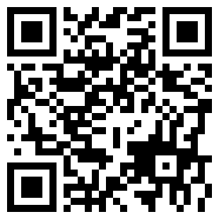
Let’s map your use cases
Your discovery deck
We walk your daily workflows together: the steps, the data, and the tools.
We pinpoint where AI agents can take the manual load off your team.
It takes about 10 minutes, and it seeds the workshop.
Scan the code or open your link to start:
http://localhost:3000/d/acme-1a2b3c

